Slide 1
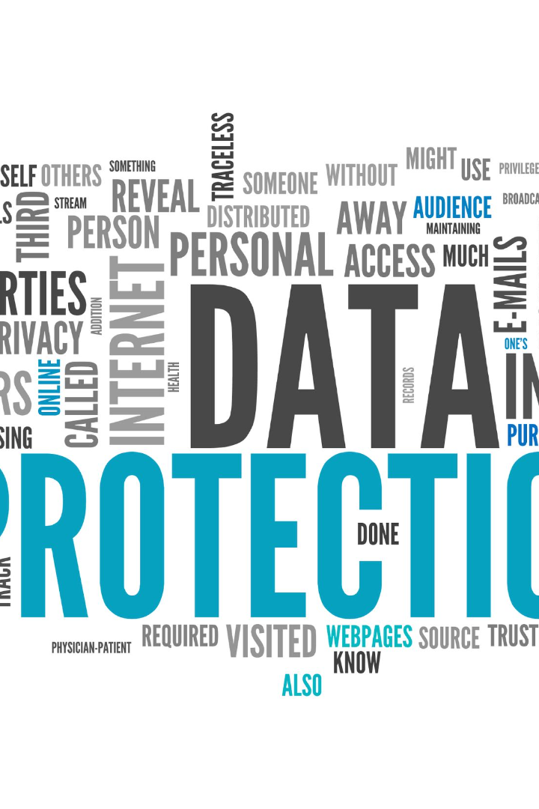
Why NLP Matters
Language is how we communicate
with one another, but it's also a
fundamental part of the digital
world. With the rise of unstructured
data, we need NLP to unlock
insights, improve user experiences,
automate tasks, and more.

Slide 2
Language as Communication Medium
1
The Power of Words 💬
2
Breaking Down Barriers 🌎
Words have the ability to inspire, motivate, and educate us. NLP is helping us better understand language and make the most of its potential.
In our globalized world, NLP tools are helping people communicate across linguistic and cultural boundaries with greater ease and understanding.
3
Unlocking Sentiment 💭
4
Translating the Web 🌐
NLP helps us understand the emotions and feelings behind words to uncover valuable insights for businesses and individuals alike.
Thanks to NLP, it's now possible for anyone to access the wealth of information on the internet, regardless of the language.

Slide 3
The Rise of Unstructured Data
1
2
3
The Volume Explosion 📈
The Variety Challenge 🌀
The Velocity Factor ⏱️
The amount of data generated each day is growing exponentially, with 90% of it being unstructured.
Data comes in many forms, from tweets to longform articles, and NLP helps us extract meaningful insights from any type of content.
Data is being created and shared at an astonishing pace, and NLP helps us keep up with the speed of information.

Slide 4
Automating Manual Tasks
Chatbots
Virtual Assistants
Document Analysis
By using NLP to understand and respond to user queries, chatbots are revolutionizing customer service and support.
NLP-powered virtual assistants like Siri and Alexa are transforming the way we interact with our devices and get things done.
NLP can quickly and accurately analyze documents for key information, saving valuable time and effort.

Slide 5
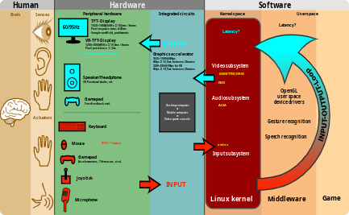

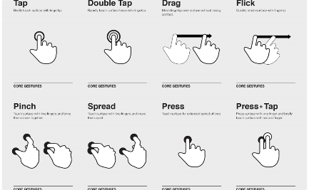
Enhancing User Experience
User Interface Design
Video Conferencing
Gesture Recognition
NLP tools help designers create more intuitive and responsive interfaces that better meet the needs of users.
NLP tools are improving the quality of virtual meetings and video chats by enabling more natural and effective communication.
NLP technology can analyze gestures and movements to improve interaction with mobile devices and wearables.

Slide 6
Enhancing Customer Engagement and Loyalty
Personalized Customer Interactions: NLP-driven chatbots and virtual assistants offer personalized responses, addressing customer inquiries and concerns in real time.
Efficient Query Resolution: NLP-enabled systems swiftly identify customer needs and provide relevant information, minimizing wait times and enhancing user experience.
Proactive Assistance: NLP anticipates customer needs by analyzing past interactions, offering proactive recommendations and assistance.
Building Customer Loyalty: Positive interactions facilitated by NLP lead to improved customer satisfaction and loyalty, fostering long-term relationships.

Slide 7
Addressing Language Diversity and Accessibility
Breaking Language Barriers: NLP facilitates communication across languages, allowing businesses to engage with a global audience and enter new markets.
Accessibility for All: NLP-driven accessibility features like speech-to-text and text-to-speech empower individuals with disabilities to interact with technology more effectively.
Cultural Sensitivity: NLP systems adapt to cultural nuances, ensuring messages are relevant and respectful in diverse linguistic contexts.
Expanding Reach: Businesses that leverage NLP for language diversity and accessibility foster inclusivity and broaden their impact.

Slide 8
Insights for Business Growth
Understanding Customer Sentiment: NLP enables businesses to analyze customer feedback from reviews, social media, and surveys. Sentiment analysis provides valuable insights into customer satisfaction and preferences.
Unveiling Market Trends: By processing vast amounts of textual data, NLP identifies emerging market trends, helping businesses stay ahead of shifts in consumer demand.
Competitor Analysis: NLP allows businesses to monitor competitors' online presence, product reviews, and customer feedback, providing insights for strategic planning.
Impact on Decision-Making: Armed with these insights, businesses can make informed decisions, refine product offerings, and tailor marketing strategies to match consumer sentiments.

Slide 9
Personalization and Recommendations
1
The Amazon Effect 📦
NLP allows companies to better understand their customers and deliver personalized recommendations and experiences that drive sales and engagement.
2
Media and Entertainment 🎬
NLP can analyze content consumption patterns to make better recommendations for movies, TV shows, and music.
3
The Power of Search 🔍
NLP helps search engines like Google deliver more accurate and relevant results to users.

Slide 10
Improving Healthcare
Diagnosis and Treatment 🏥
Mental Health 💆
Drug Discovery 🧪
NLP is helping doctors and researchers more accurately diagnose and treat conditions by analyzing medical records and research papers.
NLP-powered chatbots and therapy apps are providing access to mental health resources and support around the clock.
NLP can help identify new drug candidates and predict their effectiveness based on large-scale analysis of scientific literature.

Slide 11
Legal and Compliance
Contract Analysis 📝
NLP can help businesses analyze legal contracts and identify key terms and clauses to ensure compliance.
Compliance Monitoring 🕵️‍♂️
NLP can monitor communication channels to ensure compliance with regulations and detect potential issues before they escalate.
Intellectual Property 📚
NLP can help identify and analyze intellectual property infringements, such as plagiarism and trademark violations.

Slide 12



Education and Content Analysis
E-Learning
News Analysis
Book Summaries
NLP can analyze student performance and develop personalized learning paths and resources.
NLP can analyze news stories to identify trends and patterns and predict future events.
NLP can analyze literature and create detailed summaries for faster comprehension and review.

Slide 13

Social Media Monitoring
1
Brand Reputation 👀
2
Sentiment Analysis ❤️
NLP can monitor social channels for mentions of brands and products and alert companies to potential issues or opportunities for engagement.
NLP can help businesses understand how their products and services are being perceived by customers on social media.
3
Influencer Identification 🌟
NLP can identify and analyze the conversations of social media influencers to identify new marketing opportunities and potential partnerships.

Slide 14
Driving Innovation
1
AI and Robotics 🤖
NLP is a critical component of AI and robotics, enabling machines to interact more naturally with humans.
2
The Next Frontier 🚀
The future of NLP is bright, with new technologies and applications on the horizon, including voice assistants, chatbots, and more.

Slide 15

Conclusion: NLP's Impact and Future
NLP has already transformed the way we interact with language and digital data, and its potential for innovation and growth is limitless. As the field continues to evolve, we can expect to see even more groundbreaking applications and advancements in the years to come.

